Slide 1


Visual Studio 2019

Slide 2




Who’s this guy?
Harikrishnan
@cn_harikrishnan (https://twitter.com/cn_harikrishnan?s=08)
https://www.linkedin.com/in/hari-krishnan-304a0272
cnharishkrish@gmail.com

Slide 3
Agenda
What is Xamarin?
Why Xamarin?
What’s New in Xamarin Forms?
What’s new in VS2019 for Xamarin?

Slide 4
Why
Xamarin?

Slide 5


Slide 6


Slide 7


Slide 8

Write Once, Run Anywhere

Slide 9

Xamarin + Xamarin.Forms
iOS C# UI
Android C# UI
Windows C# UI
Shared UI Code
Shared C# Backend
Shared C# Backend
Traditional Xamarin Approach
With Xamarin.Forms: More code-sharing, all native

Slide 10
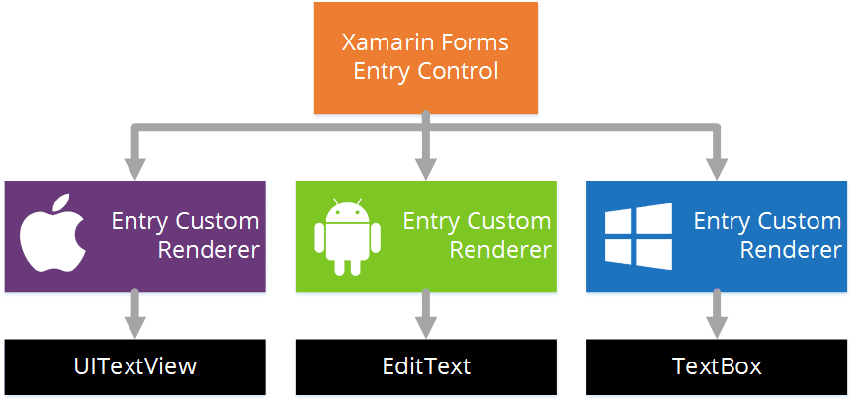
Xamarin Forms Rendering Model - Entry

Slide 11
Shared vs .NET Standard
A Shared Project is not directly compiled (.dll is not generated), instead files are compiled into .dll of project that references it
Can write platform specific code in a same file using compiler directives #ifdef
Cannot be used other than Xamarin projects
.NET projects are compiled in portable assemblies that run in any .NET based runtime.
Platform specific code cannot be implemented inside a .NET Standard project
Better usability and compatibility across other .NET platforms

Slide 12
What’s included
✓ 40+ Pages, layouts, and controls
(Build from code behind or XAML)
✓ Two-way data binding
✓ Navigation
✓ Animation API
✓ Dependency Service
✓ Messaging Center
Shared UI Code
Shared C# Backend

Slide 13
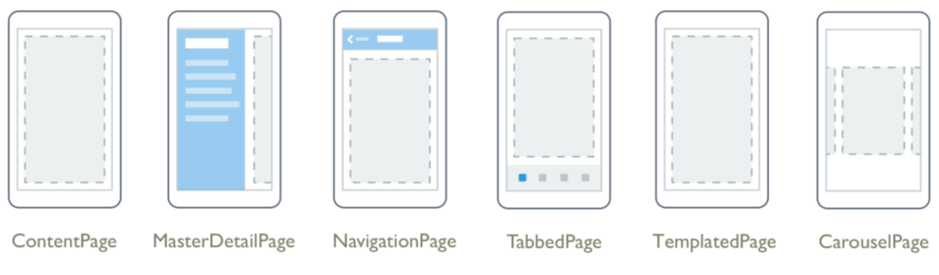
Pages

Slide 14
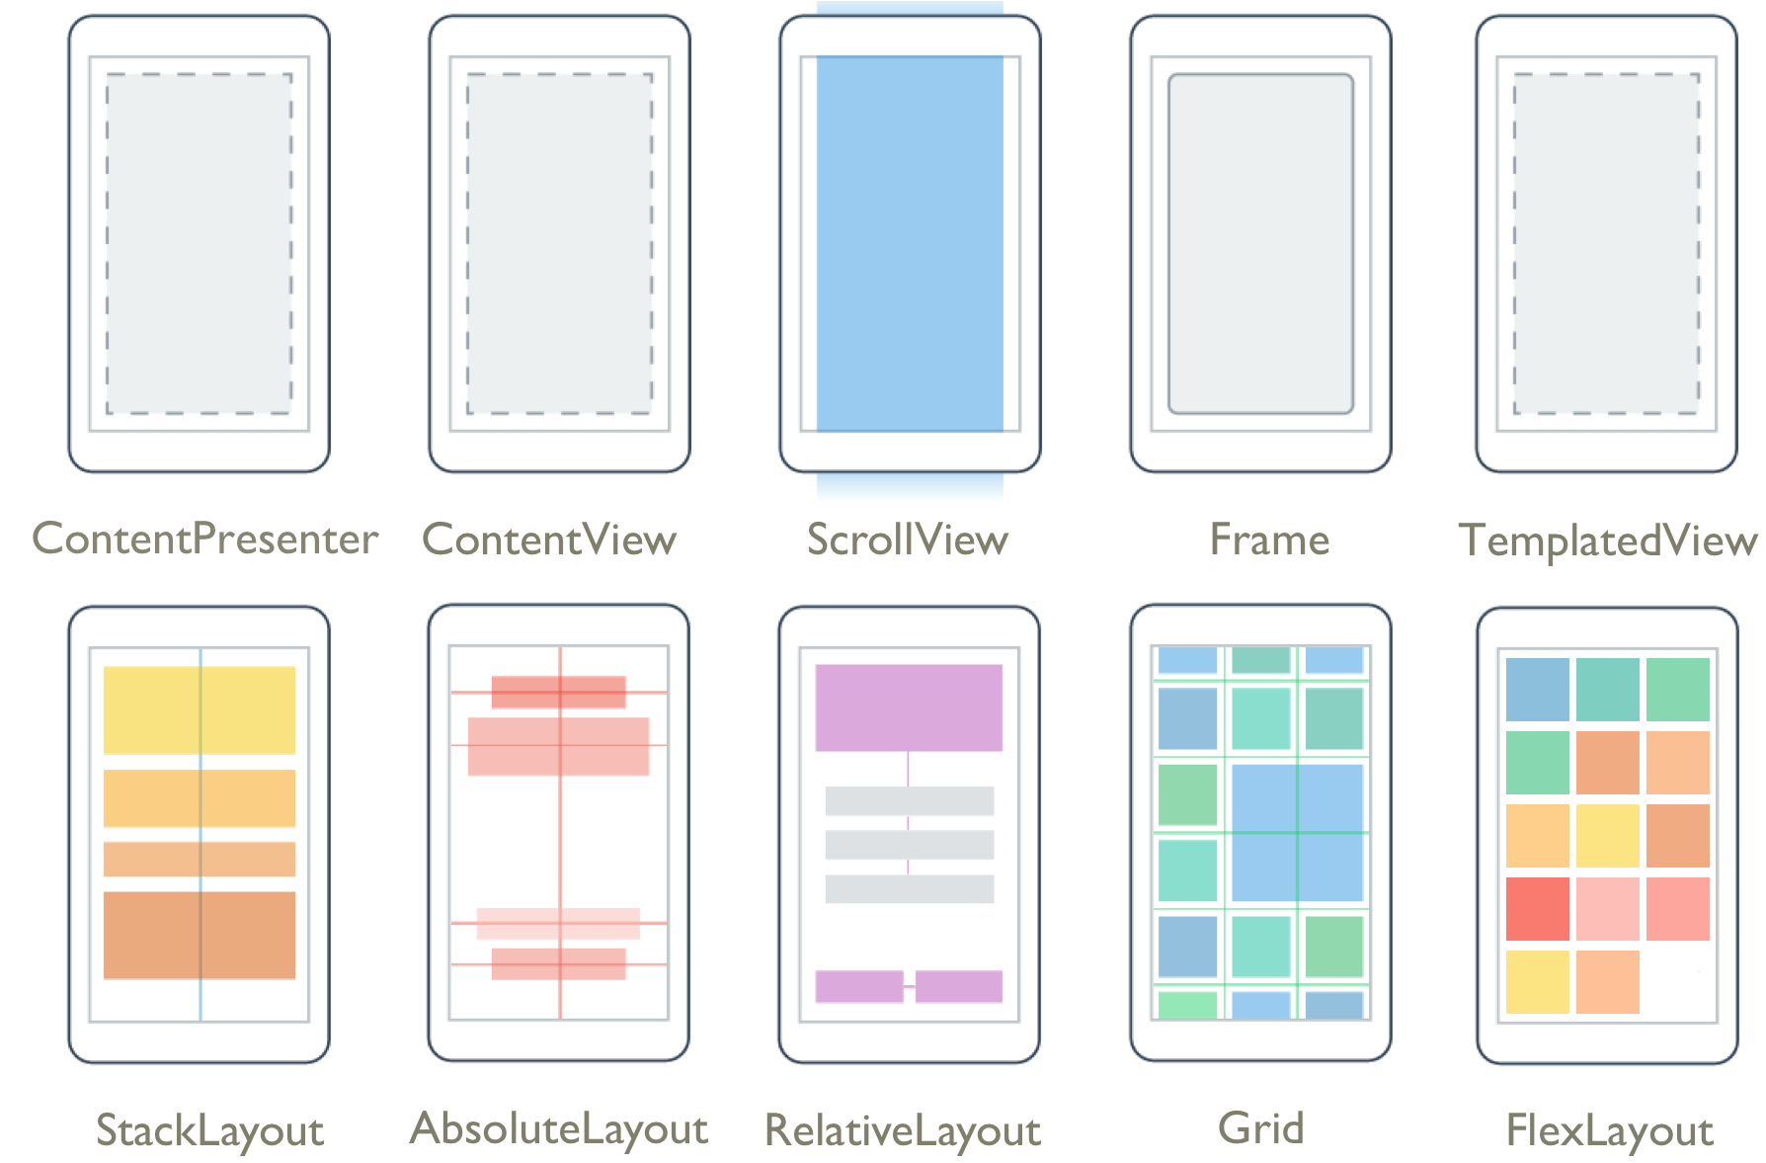
Layouts

Slide 15
Controls
ActivityIndicator
BoxView
Button
DatePicker
Editor
Entry
Image
Label
ListView
Map
OpenGLView
Picker
ProgressBar
SearchBar
Slider
Stepper
TableView
TimePicker
WebView
EntryCell
ImageCell
SwitchCell
TextCell
ViewCell

Slide 16

New Platforms
Samsung Tizen
Televisions, Wearables, Mobile
macOS
WPF
Linux: GTK#
Notes:
At the end of talking through this, I’ll do a quick intro of Jason and call him up to demo.

Slide 17
What’s new in Xamarin Forms?

Slide 18
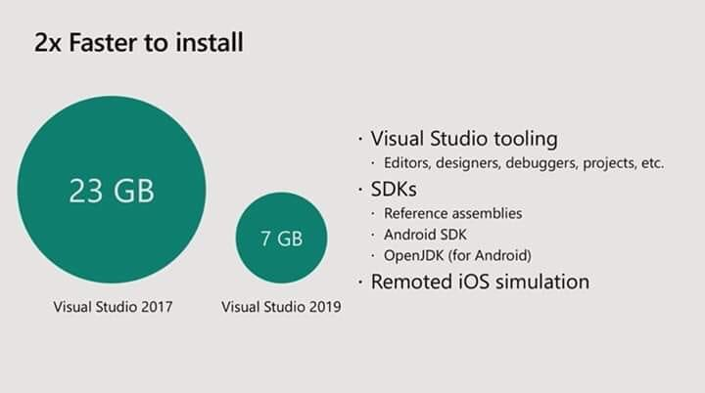
Focus on the Fundamentals
Tooling should work for you, not against you.
Lightweight installation
Xamarin workload in Visual Studio 2019 is now 3.28x smaller
Faster installation experience and a lower disk impact.
Simplified experience to acquire new Android SDKs and emulators

Slide 19
Android Announcements
Enhanced Fast Deployment for Android
Android Support Library v28

Slide 20
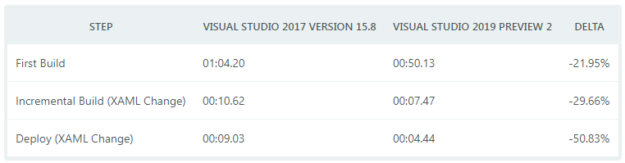
Faster Inner Development Loop
Smaller Workload Size
Visual Studio 2019 have decreased the size of the Xamarin workload by 50%!

Slide 21
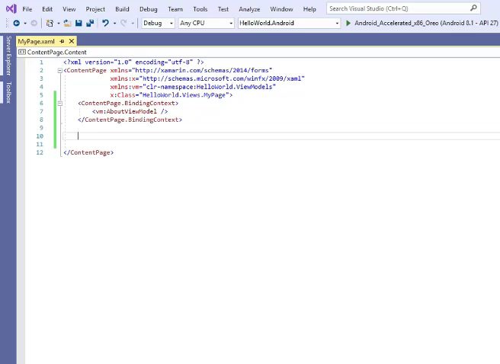
XAML IntelliSense and Intellicode

Slide 22
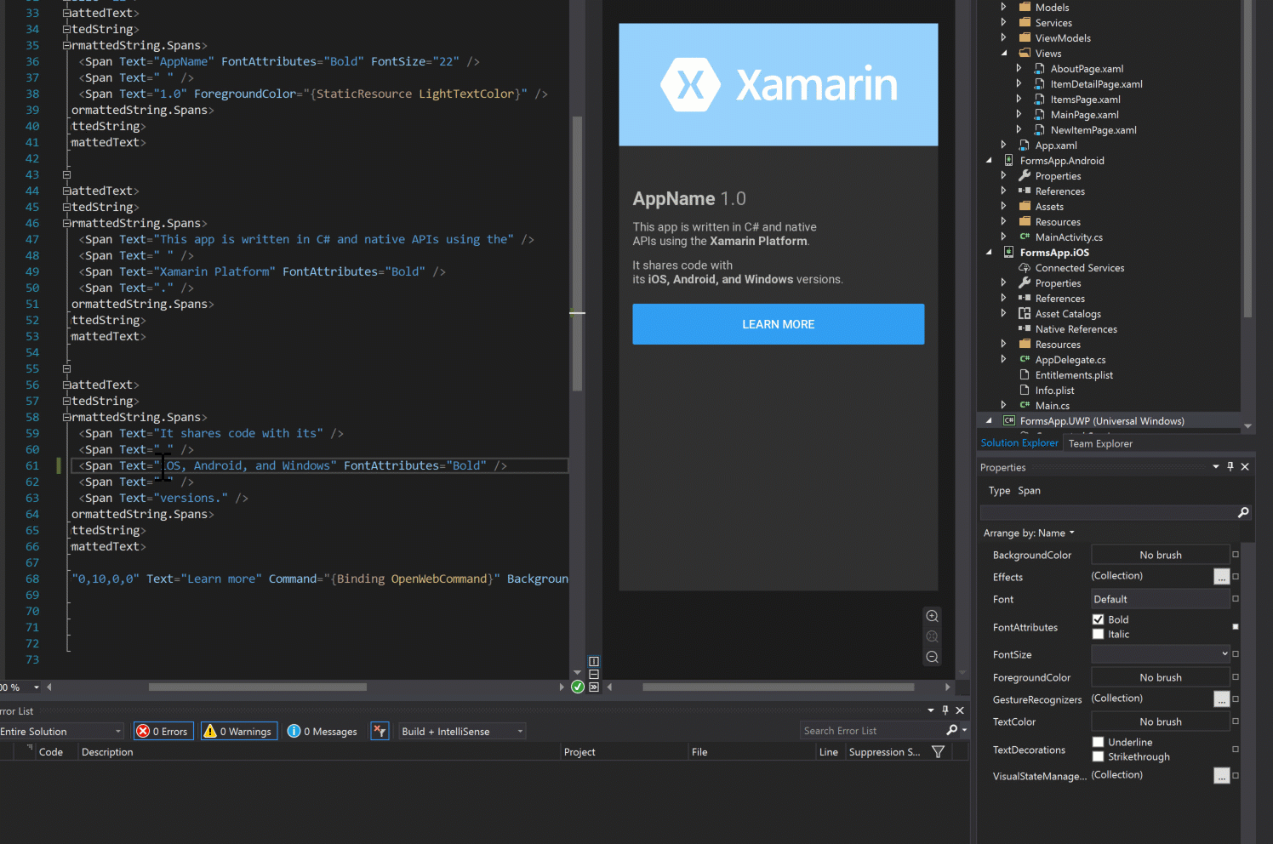
Xamarin.Forms Property Panel

Slide 23
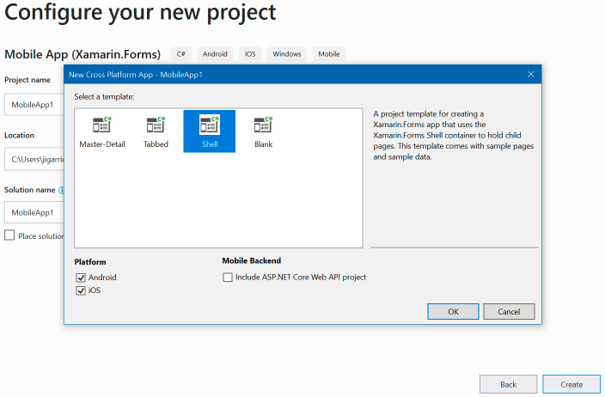
Xamarin Forms Shell Template
Shell provides a guided structure for setting up your applications navigation UI, a powerful new URI based navigation service, performance conscious data templates.
Forms.SetFlags(“Shell_Experimental");

Slide 24
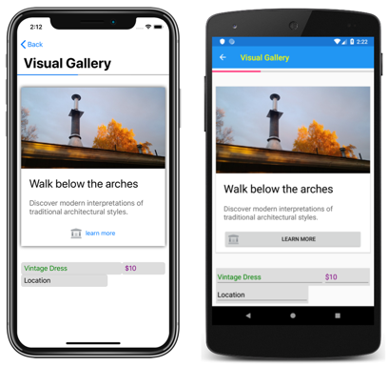
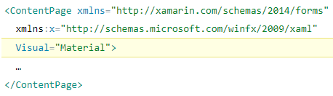
Consistent UI with Visual
Forms.SetFlags("Visual_Experimental");

Slide 25
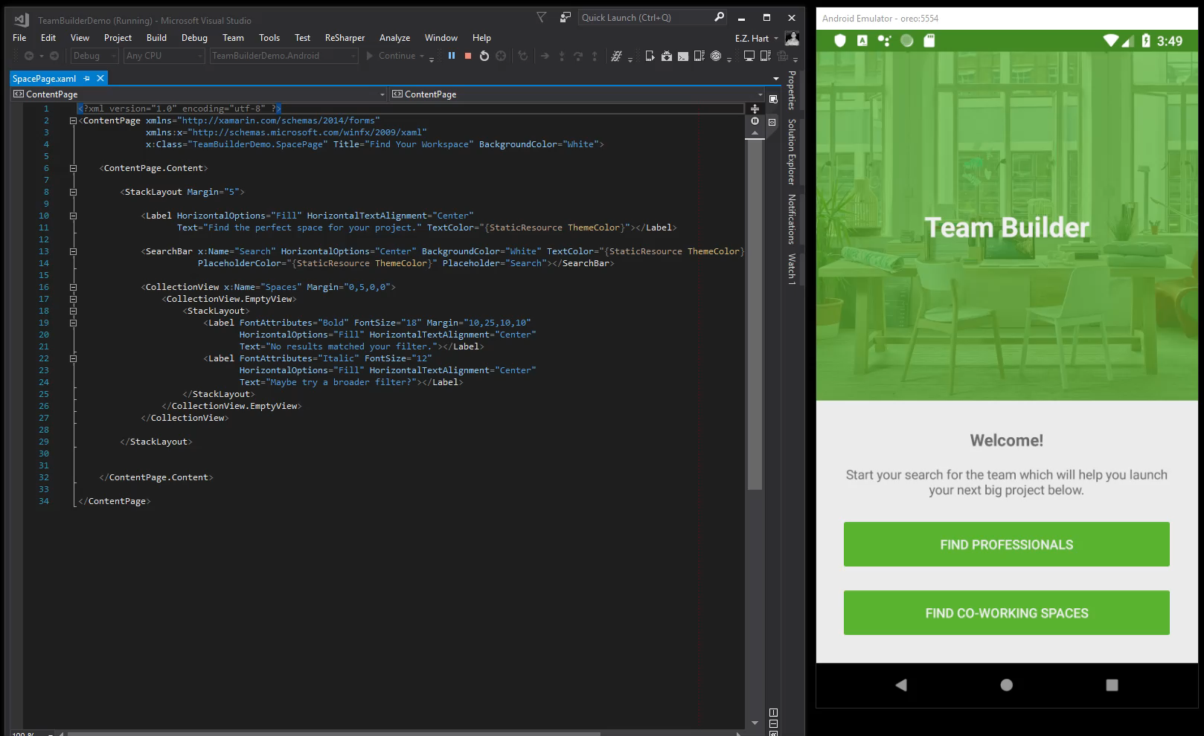
Xamarin.Forms CollectionView
Forms.SetFlags("CollectionView_Experimental");

Slide 26
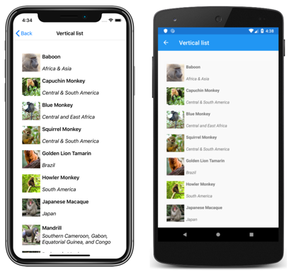

Slide 27
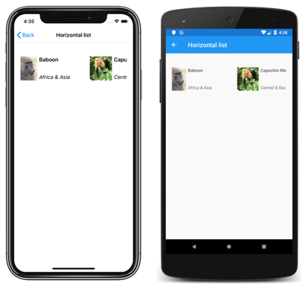

Slide 28
Cross-Platform Access to Platform Services
Xamarin.Essentials 1.0 is now available.
Easier than ever to access non-UI platform APIs from shared code.
Supported Platforms
iOS (10+)
Android (4.4+)
https://github.com/xamarin/Essentials

Slide 29
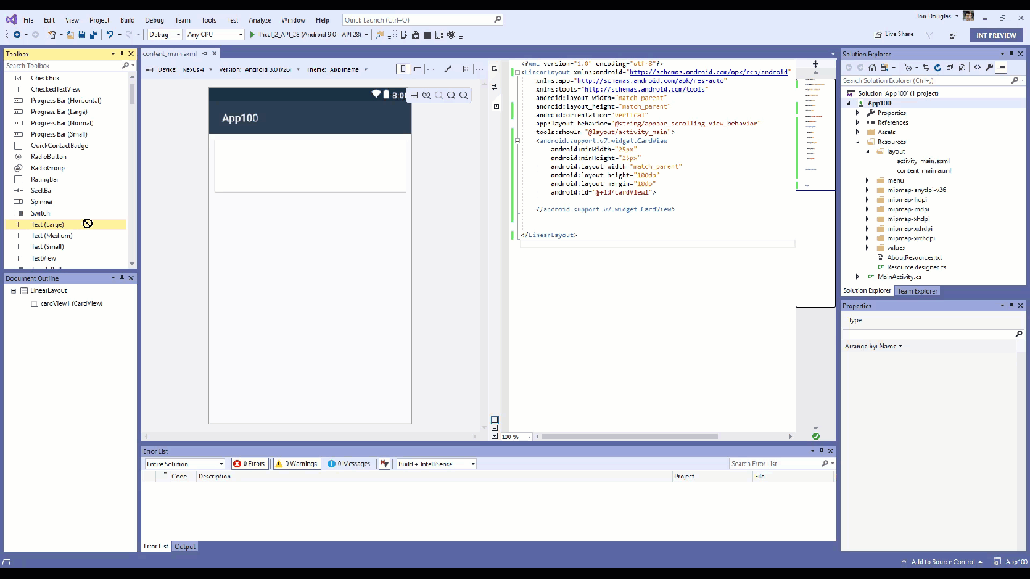
Xamarin Android Designer

Slide 30
What’s new in VS2019 for Xamarin?

Slide 31
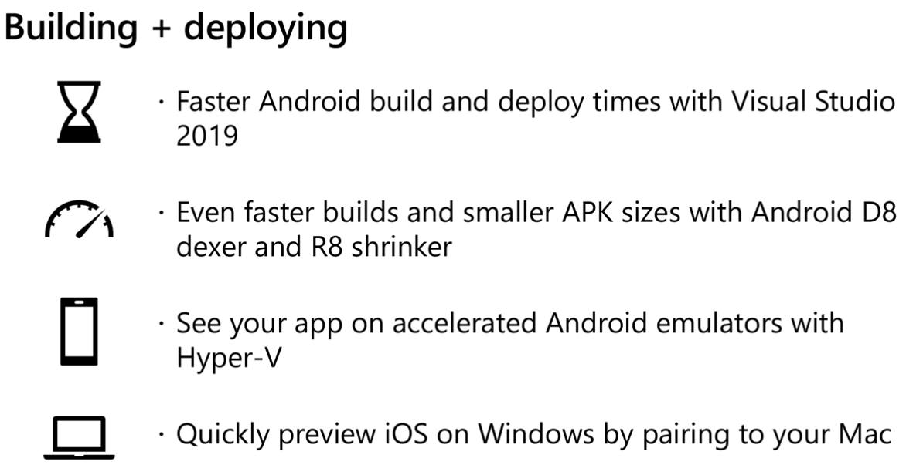

Slide 32
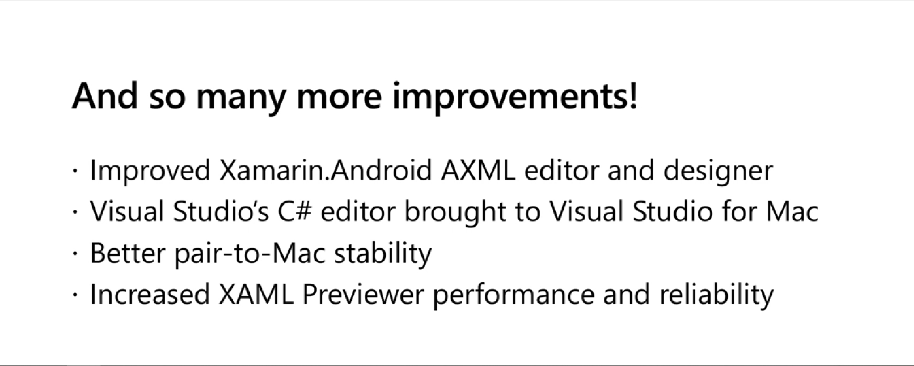

Slide 33
More…
https://devblogs.microsoft.com/xamarin/xamarin-visual-studio-2019/
https://docs.microsoft.com/en-us/visualstudio/releases/2019/release-notes#mobile-development-with-xamarin

Slide 34

Any Queries?
Harikrishnan
@cn_harikrishnan (https://twitter.com/cn_harikrishnan?s=08)
☺
https://www.linkedin.com/in/hari-krishnan-304a0272
cnharishkrish@gmail.com

